Slide 1



Management information assistant
9th July 2018
Harsh Srivastava
Navreet Kaur
Yogesh Kumar
Piyush Singh

Slide 2
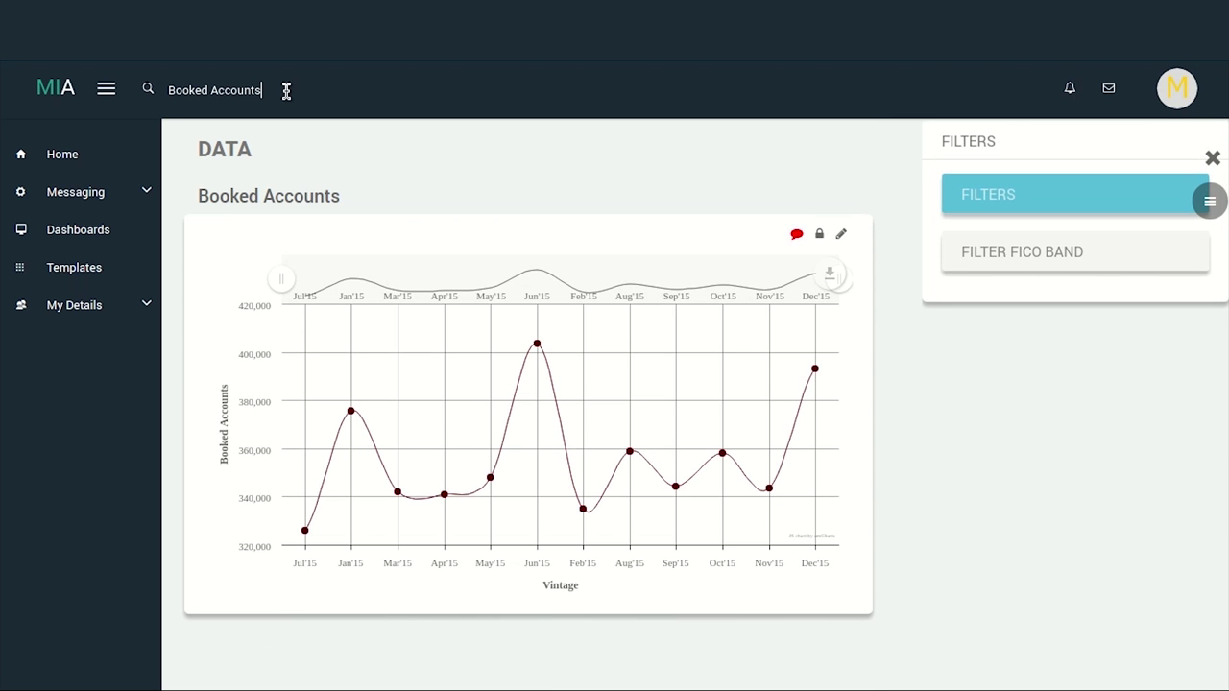
About MIA
What is MIA ?
MIA is a search based analytical tool which uses simple query, written in plain English, to fetch relevant data from the database and display information in a meaningful manner for drawing insights. It also contains built-in templates for commonly used reports in different industry to expedite MIS set-up
MIA Search
MIA Insights
MIA Dashboard
COMPONENTS
Notes:
Why create an interface b/w NL and SQL?
business analysts – don’t need tech knowledge
Importance- Important data is being generated today on unprecedented levels. Need to have efficient interface which can allow you to draw inferences and insights without having to have tech knowledge
In our context, first element of pipeline, hence accuracy of other results highly dependent on search accuracy; enables non tech team member to access data quickly and easily using their own language without the need for expensive developers or database professionals
Why is this complex?
current research topic because of its importance
interpretation is highly dependent on context, sentence phrasing and domain knowledge
Grammar is important - Flying planes is dangerous / Flying planes are dangerous
We can’t use ML because of our unique situation, will do in detail in later part of presentation (absence of training data)
EG: Who is the richest person in the world?;Which state has the maximum interest rate?; Flying planes can be dangerous; Time flies like an arrow; fruit flies like a banana
Why is search complex and important [Complexity- interpretation is highly dependent on context, sentence phrasing and domain knowledge (EG: Who is the richest person in the world?;Which state has the maximum interest rate?; Flying planes can be dangerous; Time flies like an arrow; fruit flies like a banana).
[Importance- Important data is being generated today on unprecedented levels. Need to have efficient interface which can allow you to draw inferences and insights without having to have tech knowledge. In our context, first element of pipeline, hence accuracy of other results highly dependent on search accuracy; enables non tech team member to access data quickly and easily using their own language without the need for expensive developers or database professionals ]

Slide 3




Current state of competitors v/s mia
MIA
Tableau
Kueri
Limited to SELECT and WHERE clause
No co-reference resolution
No co-reference resolution
No support for multiple queries
Takes semi-structured queries
NLQ support still in development
Working on conversation based queries
No co-reference resolution
No support for multiple queries
Power BI
No support for multiple queries

Slide 4
Current MIA Search
COMPLICATIONS
LIMITATIONS
Employs linear search
Ignores the relative position of words and hence the context; similar to bag-of-words model
Reliable identification of queries with basic structure
Sole reliance on ‘trigger words’ for deciphering query’s structure undesirable
Unable to robustly handle nested queries or complex queries that have coreferences and multiple, varied conditions
DESIRABLE FEATURES
Database independence
Minimal preprocessing of database
Minimal dependence on hard-coded features like trigger words
Scalable and robust enough to handle complex and nested queries
Resilient to variations in NL query occurring due to English grammar and sentence structure
Use concepts and techniques of machine learning for natural language processing (NLP)
Notes:
Reliance on trigger words Over – what is the avg credit score over property state? What are the states with avg credit score over 600?
Bag of words model English is context dependent; need to preserve the sentence structure
Desirable Features
Why ML can’t be employed?
Why can’t we use existing NLP techniques out of the box [Hint- Models are trained on particular dataset]?
Problems specific to our domain [dataset can keep changing, can’t retrain always, column names which are major part of queries are generally not meaningful words and database specific].
Need for using something universal across all queries on datasets –ENTER –English grammar.

Slide 5
Researching Existing Approaches
ideation
Seq2SQL: Generating Structured Queries from Natural Language using Reinforcement Learning [Zhong et al. 2017 (Salesforce)] ^{[1]}
This approach uses reinforcement learning along with supervised learning to creating structured queries from NL queries. Limited only to generating SELECT and WHERE clause
NL2Prog: Pointing Out SQL Queries From Text [Wang et al. 2017 (Microsoft Research)] ^{[2]}
Improvement over Seq2SQL using only supervised learning and a bidirectional LSTM.
SQLNet: Generating Structured Queries From Natural Language Without Reinforcement Learning [Xu et al. 2017 (UC Berkley)] ^{[3]}
Employs dependency tree and sketch based approach for generating SQL queries
TypeSQL: Knowledge-based Type-aware Neural Text-to-SQL Generation [Yu et al. 2018 (Yale University)] ^{[4]}
Views the problem as a slot filling task and uses type information
Notes:
Most recent papers in the field – All use ML- same problem

Slide 6

NLQ2SQL
A slot filling approach to converting NL query to SQL query
Notes:
what are the property state having credit score above 700 for people having prepayment penalty mortgage flag
Negation handling
show postal code not having prepayment penalty mortgage flag
show postal code where there isn't any prepayment penalty mortgage flag
what are the postal code without prepayment penalty mortgage flag
Show me the property state, property type and channel for people who neither have credit score above 650 nor original interest rate below 6
Columns need not be near
which are the property state having original interest rate except 7, with prepayment penalty mortgage flag
Aggregator Mapping
show maximum and minimum credit score, minimum and average original interest rate and the loan purpose for people with prepayment penalty mortgage flag, living in New York with a condo
Logical operations
what are the property type available in California and New York ?
what is the loan purpose for people living in NY and having 8 as original interest rate
Order/Group
Count the loans with original interest rate over 6.5 across property state
Show the property type for people in top 25% according to credit score

Slide 7
FREDDIE MAC
DATASET
Metadata
Credit Score
Property State
Property Type
Loan purpose
First time homebuyer
Super conforming flag
Original interest rate
Original UPB
Penalty flag
Seller name
Loan sequence number
……
Starling
Network of column nodes, value nodes, operator nodes depicting relations between them
Helps in identification and mapping of words in query to their corresponding columns/ values/ operators/ aggregators
Space
FreddieMac
Property_state
Credit score
FIFA
Player_name
CA
NY
Credit Score
Numeric
Property State
String
Penalty Flag
Bool
Loan Purpose
String
Column
Datatype
Notes:
what are the property state having credit score above 700 for people having prepayment penalty mortgage flag
Negation handling
show postal code not having prepayment penalty mortgage flag
show postal code where there isn't any prepayment penalty mortgage flag
what are the postal code without prepayment penalty mortgage flag
Show me the property state, property type and channel for people who neither have credit score above 650 nor original interest rate below 6
Columns need not be near
which are the property state having original interest rate except 7, with prepayment penalty mortgage flag
Aggregator Mapping
show maximum and minimum credit score, minimum and average original interest rate and the loan purpose for people with prepayment penalty mortgage flag, living in New York with a condo
Logical operations
what are the property type available in California and New York ?
what is the loan purpose for people living in NY and having 8 as original interest rate
Order/Group
Count the loans with original interest rate over 6.5 across property state
Show the property type for people in top 25% according to credit score

Slide 8
Features
NLQ2SQL
Support of only single query for now, can be expanded for more complex queries
Utilizes dependency tree (generated using commercial open-source software) instead of relying on fixed window size based approach
Database independent – uses the Starling structure already in use by MIA
Negation handling
Queries don’t necessarily need to have columns and their values near each other to create a filter
Many to one aggregator mapping
Infer logical operations to be performed in case of multiple filters
Can be potentially expanded to provide all functionalities provided by queries written in SQL
Natural Language Query
Complex
Co-references
Nested
Parallel
Simple
Notes:
Bag of words model is highly inefficient for the task, we need a model that can draw meaning from the sentence structure and context– ENTER- Dependency tree ]
NOT SINGLE QUERIES:
- What is the credit score for people in NY and what is the loan purpose for people whose credit score is more than 500? - PARALLEL
what are the property state having credit score above 700 for people having prepayment penalty mortgage flag
Negation handling
show postal code not having prepayment penalty mortgage flag
show postal code where there isn't any prepayment penalty mortgage flag
what are the postal code without prepayment penalty mortgage flag
Show me the property state, property type and channel for people who neither have credit score above 650 nor original interest rate below 6
Columns need not be near
which are the property state having original interest rate except 7, with prepayment penalty mortgage flag
Aggregator Mapping
show maximum and minimum credit score, minimum and average original interest rate and the loan purpose for people with prepayment penalty mortgage flag, living in New York with a condo
Logical operations
what are the property type available in California and New York ?
what is the loan purpose for people living in NY and having 8 as original interest rate
Order/Group
Count the loans with original interest rate over 6.5 across property state
Show the property type for people in top 25% according to credit score
Order/Group
Count the loans with original interest rate over 6.5 across property state
Show the property type for people in top 25% according to credit score

Slide 9
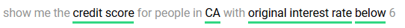
Nlq2sql
Slot filling approach – relevant features from the NL query are identified which are then be used to populate the generic SQL query structure
Grammatical and syntactical features of English are used to reliably convert NL queries to SQL
Current generic SQL query structure:
Uses dependency parse tree of the NL query to handle non-linear search
Rule based approach, independent of the database
Utilizes components of previously implemented model
Starling structure enables identification of columns, values and operators in the NL query
Metadata
SELECT
WHERE
SQL Query
GROUP BY
ORDER BY
LIMIT
Operator node
Column node
Value node
Notes:
what are the property state having credit score above 700 for people having prepayment penalty mortgage flag
Negation handling
show postal code not having prepayment penalty mortgage flag
show postal code where there isn't any prepayment penalty mortgage flag
what are the postal code without prepayment penalty mortgage flag
Show me the property state, property type and channel for people who neither have credit score above 650 nor original interest rate below 6
Columns need not be near
which are the property state having original interest rate except 7, with prepayment penalty mortgage flag
Aggregator Mapping
show maximum and minimum credit score, minimum and average original interest rate and the loan purpose for people with prepayment penalty mortgage flag, living in New York with a condo
Logical operations
what are the property type available in California and New York ?
what is the loan purpose for people living in NY and having 8 as original interest rate
Order/Group
Count the loans with original interest rate over 6.5 across property state
Show the property type for people in top 25% according to credit score

Slide 10
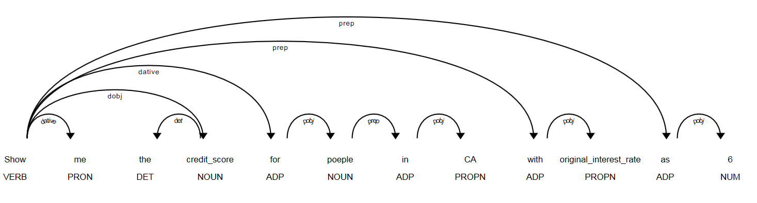
Algorithm
SELECT
WHERE
SQL Query
GROUP BY
ORDER BY
LIMIT
Dependency Tree
Dependency parsed tree is used to fill the SELECT slots with relevant column nodes
Show me the credit score for people in CA with original interest rate as 6
Notes:
what are the property state having credit score above 700 for people having prepayment penalty mortgage flag
Negation handling
show postal code not having prepayment penalty mortgage flag
show postal code where there isn't any prepayment penalty mortgage flag
what are the postal code without prepayment penalty mortgage flag
Show me the property state, property type and channel for people who neither have credit score above 650 nor original interest rate below 6
Columns need not be near
which are the property state having original interest rate except 7, with prepayment penalty mortgage flag
Aggregator Mapping
show maximum and minimum credit score, minimum and average original interest rate and the loan purpose for people with prepayment penalty mortgage flag, living in New York with a condo
Logical operations
what are the property type available in California and New York ?
what is the loan purpose for people living in NY and having 8 as original interest rate
Order/Group
Count the loans with original interest rate over 6.5 across property state
Show the property type for people in top 25% according to credit score

Slide 11
Sample Queries
Performance EVALUATION
NL Query | SQL Query | NLQ2SQL | MIA Search
What are the property type available in California and New York? | SELECT property type WHERE property state== CA or property state==NY | YES | YES
Show maximum and minimum credit score for people with a condo in NY | SELECT MAX, MIN credit score WHERE property type==CO and property state==NY | YES | NO
Show original interest rate for people in top 25% by credit score | SELECT TOP 25 PERCENT original interest rate ORDER BY credit score DESC | YES | NO
What is the seller name for people with credit score not less than 750 in NY across property type? | SELECT seller name WHERE credit score >=750 and property state==NY GROUP BY property type | YES | NO
Display top 5 loan sequence number according to original interest rate | SELECT loan sequence number ORDER BY original interest rate DESC LIMIT 5 | YES | NO
Show loan sequence number having super conforming flag equal to penalty flag | SELECT loan sequence number WHERE super conforming flag == penalty flag | NO | NO
What is the monthly average original interest rate for loans issued in NY? | SELECT AVG original interest rate WHERE property state == NY GROUP BY issue date | NO | NO
On average, what is the original loan term across property state ? | SELECT original interest rate GROUP BY property state | NO | NO
Accuracy
76%
NLQ2SQL model tested on 100 natural language queries* on Freddie Mac data
* Non inclusive of queries involving date nodes and nested queries,

Slide 12
NLQ2SQL
Future steps
Improvement in accuracy through reinforcement learning by using user feedback or employing evolutionary algorithms to improve rules
Ambiguity resolution – one-to-many, many-to-many relationship between aggregators and columns
Handle wider range of queries using a dynamic SQL sketch structure
Classification and interpretation of nested and parallel queries
Using date filters such as Q1, last year, 2016 etc.
Support for inference statistics
Integration with Co-reference resolution
Natural Language Query
Complex
Co-references
Nested
Parallel
Simple
Types of queries
Notes:
Column to column comparison
show loan sequence number having super conforming flags same as prepayment penalty mortgage flag
Ambiguity- many-to-one, many-to-many
what is the average original interest rate and original upb for people in NY
what is the maximum and average original upb and credit score for people of NY
Date filters
Show me the average original upb for Q1 – 2017
what is the monthly average original interest rate for loans issued in NY

Slide 13

RESOLVING COREFERENCES IN QUERIES
CorefQ model
To replace this image Click on the upper left corner of it, select Shape Fill / Picture… / then browse to select a 7.38” W X 7.5” H image

Slide 14
“Relationship between two words or phrases in which both refer to the same person or thing”
Co-reference in a query
Ex:
John works at EXL. He loves analytics.
Here, “He” refers to “John”.
Co-referential queries in mia search engine:
Ex:
Display the credit score of customers and sort its average value across channel.
Here, “its” refers to “the credit score of customers”
Seller name of top 5 credit score and sum of their original combined loan to value.
Here, “their” refers to “top 5 credit score”

Slide 15
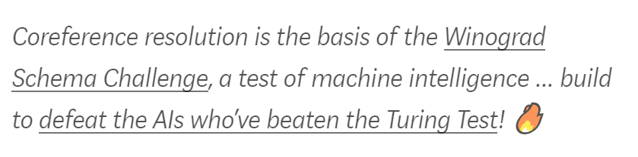
CO-REFERENCE RESOLUTION IS TRICKY!
Humans naturally associate these references together — but for an AI brain, it is much more difficult! And when we say it is hard, we mean it,
100% ACCURACY IS IMPOSSIBLE!
The best Team competing for the Winograd Schema Challenge last year reached only 58% of success.

Slide 16

BEFORE
Need for co reference resolution in MIA
AFTER
Semi structured query for searching data
Incompetency in interpreting co-referential queries
Inability to process multiple sub queries simultaneously
EXAMPLES
Natural language query for searching data
Ability to understand co-referential queries
Competent enough to solve multiple queries simultaneously
EXAMPLES
Seller name of top 5 credit score
Seller name of top 5 credit score and their original loan to value sum
top 5 credit score original loan to value sum

Slide 17





Competitor analysis
FEATURES
SIMPLE QUERY
CO-REFERENCE QUERY
MULTIPLE QUERIES
INDEPENDENCE TEST

Slide 18
APPROACH
Finding appropriate co-references in the query if it exists
Mapping co-references with most significant replacements.
Split the resulting query into multiple independent queries

Slide 19
SOLUTION
Split Sentence Module
Independence Test Module
Rule Book Module
Co-reference Module
Neuralcoref model is the base model for mention identification in the query
Returns the most representative co-referntial pronoun and its most likely replacement from the list of mentions
Returns list of potential replacements of the most representative co-referential pronoun
Utilizes field name information, NER tagging, proximity from most representative mention
Excludes replacement having the most representative pronoun in it
Dependency tree is constructed for the input query
Co-referential pronoun is identified and taken as the starting node
From the starting node tree is traversed by BFS methodology and the node having the closest conjunction is taken as the point to split in the query.
Takes in the output of split sentence as input.
Returns the list of independent queries as output

Slide 20
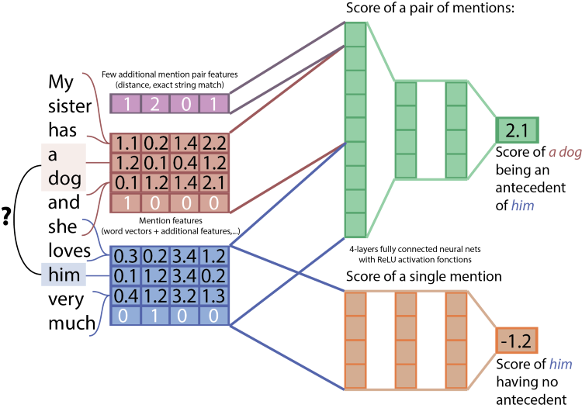
NEURALCOREF ARCHITECTURE
Two parallel neural network
First neural network gives score of each pair of mentions and a possible antecedent to mention
Second neural network gives score of a mention having no antecedents
Compares all the scores to determine whether a mention has antecedent and which one it should be

Slide 21
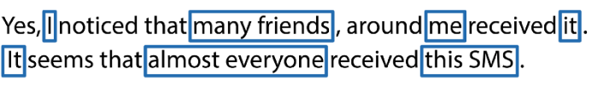
How NeuralCoref works?
Mentions | I | many friends | me | it | It | almost everyone | this SMS
I | 1.75
many friends | -1.48 | 1.76
me | 1.03 | -0.53 | -0.42
it | -1.61 | -1.91 | -3.76 | 1.76
It | -1.81 | -1.76 | -4.01 | -1.31 | 2.14
almost everyone | -1.50 | -0.86 | -3.90 | -1.5 | -1.5 | 1.82
this SMS | -1.49 | -3.6 | -1.47 | 3.47 | -1.23 | -2.76 | -0.36

Slide 22

Demonstration
Input Query:
How many customers purchased property type Condo and display their seller name?

Slide 23
CO REFERENCE MODULE
Split Sentence Module
Independence Test Module
Rule Book Module
Co-reference Module
INPUT QUERY:
How many customers purchased property type condo and display their seller name?
OUTPUT:
MENTION LIST: Potential mentions referring to common entity
[How many customers, property_type, property_type condo, their, their seller_name, seller_name]
MOST REPRESENTATIVE PAIR: Co-referential pronouns and most probable replacement
{their: How many customers}

Slide 24
RULE BOOK MODULE
Split Sentence Module
Independence Test Module
Rule Book Module
Co-reference Module
INPUT QUERY:
How many customers purchased property type condo and display their seller name?
INPUT to RULEBOOK:
Mention List & Co-referential pronouns (from Co-reference Module)
OUTPUT:
Most probable replacement List: (Output of customized filters specific to datasets)
{their: [property_type, property_type condo]}

Slide 25
SPLIT SENTENCE MODULE
Split Sentence Module
Independence Test Module
Rule Book Module
Co-reference Module
INPUT QUERY:
How many customers purchased property type condo and display their seller name?
INPUT to Split Sentence Module:
Input Query & Co-referential Pronoun (from Co-reference Module)
OUTPUT:
Simple Queries: Co-referential queries split into simple queries with replacements
['How many customers purchased property_type Condo ', 'display property_type condo seller_name ']

Slide 26
INDEPENDENCE TEST MODULE
Split Sentence Module
Independence Test Module
Rule Book Module
Co-reference Module
INPUT QUERY:
How many customers purchased property type Condo and display their seller name?
INPUT to Independence Test Module:
Split Sentence (from split sentence module)
OUTPUT:
Boolean: Returns whether list of queries are Independent
['How many customers purchased property_type Condo ', 'display property_type condo seller_name ']
TRUE (As first query returns a numeric type while second returns a table)

Slide 27
RESULTS
QUERY | RESOLVED QUERIES | RESOLVED STATUS
Display the credit score and sort its average value across channel? | Display the credit_score sort the credit_score average value across channel | CORRECT
List loans of CA? Display their average credit score | List loans of CA Display ca average credit score | CORRECT
Display the credit score of customers and group it across channel. | Display the credit_score of customers group the credit_score across channel ' | CORRECT
Display first time homebuyer flag and their average credit score? | Display first_time_homebuyer_flag first_time_homebuyer_flag average credit_score | CORRECT
What is average original loan to value ratio and average original combined loan to value and their sum? | What is average original_loan_to_value_ratio and average original_combined_loan_to_value original_combined_loan_to_value sum | INCORRECT
Accuracy:
61.25%
CorefQ model tested on 80 co-referential queries, resulted in 49 correct mapping

Slide 28
Coreference Resolution
NEXT STEPs
IMPROVING MODEL ACCURACY:
Neuralcoref model is trained on formal data sets like newspaper articles and web articles, hence it requires input as formal query.
Model can be trained on informal data sets like conversational chats, social media posts to improve its performance for informal query.
IMPROVING GRAMMATICAL SENSE:
Instead of replacing the co referential pronoun directly with its most probable replacement, which results in grammatically incorrect sentence.
Semantic Association and Concept Net can help us in reconstructing the sentence to improve its grammatical accuracy.

Slide 29
References
Seq2SQL: Generating Structured Queries from Natural Language using Reinforcement Learning (Victor Zhong, Caiming Xiong, Richard Socher) Link: https://arxiv.org/abs/1709.00103
NL2Prog: Pointing Out Sql Queries From Text (Chenglong Wang, Marc Brockschmidt & Rishabh Singh) Link: https://www.microsoft.com/en-us/research/wp-content/uploads/2017/11/nl2prog.pdf
SQLNet: Generating Structured Queries From Natural Language Without Reinforcement Learning (Xiaojun Xu, Chang Liu, Dawn Song) Link: https://arxiv.org/abs/1711.04436
TypeSQL: Knowledge-based Type-Aware Neural Text-to-SQL Generation (Tao Yu, Zifan Li, Zilin Zhang, Rui Zhang, Dragomir Radev) Link: https://arxiv.org/abs/1804.09769v1
Neuralcoref: Deep Reinforcement Learning for Mention-Ranking Coreference Models.
(Kevin Clark and Christopher D. Manning)
Link: https://cs.stanford.edu/people/kevclark/resources/clark-manning-emnlp2016-deep.pdf
All stock images taken from Pexels.com, free for personal and commercial use without the need for attribution Link: https://www.pexels.com/

Slide 30
Thank you
NLQ2SQL
CorefQ
Navreet Kaur
IIT Delhi
navreet.kaur2@exlservice.com
Yogesh Kumar. S
IIT Kharagpur
yogesh.kumar2@exlservice.com
Harsh Srivastava
IIT Bombay
harsh.srivastava@exlservice.com
Piyush Singh
IIT Kharagpur
piyush.singh@exlservice.com

